Slide 1
Out Of Time: The Game
B00349622 – Kieran Lewis
B00349036 – Steven Benson
B00357866 – Angelika Kolodziej

Slide 2
Game idea & Overview
Out of Time is a Time Travelling 2D Side Scrolling Shooter
The game takes place in many different settings from Ancient Egypt all the way to the future of 2084
We thought a time travelling game would be fun as nowadays it’s quite rare.
We wanted a wacky style of time travel not a chronological order or a specific “the character knows where he’s going”

Slide 3
Game IDEA AND OVERVIEW CONTINUED
We wanted full control of the implementation, we wanted Health pickups, ammo pickups and new weapons for the player to use.
We wanted a boss at the end of the game who was behind everything but this had to be scrapped in the prototype

Slide 4
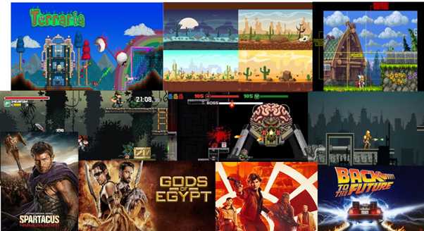
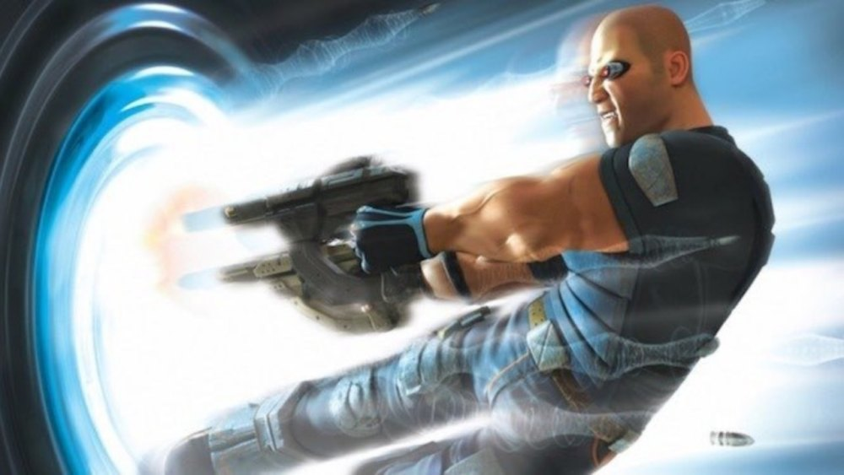
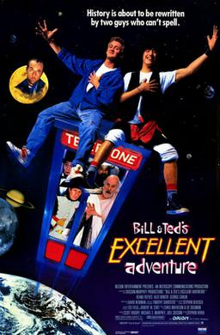
Inspiration
The game was heavily inspired from the Time Splitters series with some inspiration from films like Back to the Future, Bill and Ted’s Excellent Adventure and the TV show Doctor Who.

Slide 5
Game Engine Choice
We chose Unity 2017.3.1f1 because Kieran was more experienced in it compared to Unreal Engine 4.
It has worked in the past for many projects
Steven has good experience in Unreal Engine however he wanted to use Unity to build his skills in it again
It is easy to use and very user friendly
We didn’t use Unreal Engine because we haven’t ever made a 2D game in it

Slide 6
Gameplay and Mechanics
The game plays like a 2D Shooter.
The player moves along a linear path throughout each level and kills each enemy to get by them
Included a gun switching mechanic to spice up the game allowing multiple ways to defeat various enemies. Each gun performs differently from each other
We wanted the game to feel quite fast however the game was slower paced at first

Slide 7
Gameplay and mechanics continued
Various enemies in the game that act differently. If certain enemies are hit too much then they will be slower
There are platforms that can move which a new sense of playability to the game.
There was originally to be a pistol, assault rifle, shotgun and a laser pistol/rifle however this was changed as the assault rifle was basically that.
Kieran created and implemented a Rocket Launcher to the game as a replacement

Slide 8
Team Roles
Angelika joined the group on Week 3 which meant our work load could increase and it also meant that the workload was more evenly spread.
Before this Kieran was Lead Programmer and Steven was Lead Artist.
Angelika became a team artist with Steven as she was good at art.

Slide 9
Level Design
We wanted each level to feel different but to still be similar to the overall gameplay loop
Each level plays differently from the last one and each level is in a completely different time zone
The levels progress in difficulty
Steven hasn’t finalised the final level designs but here are some pictures from the alpha of the game

Slide 10
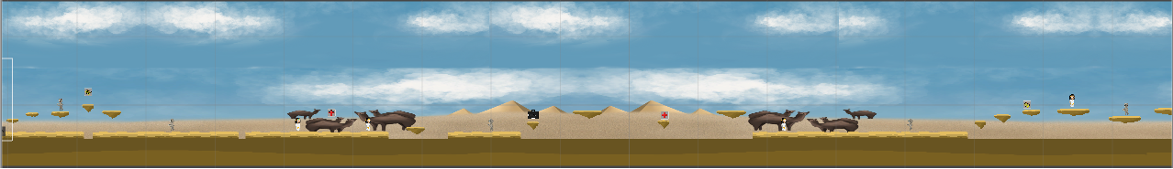
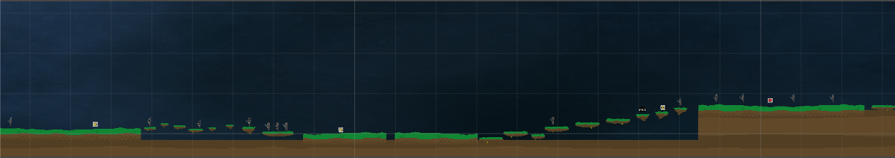
Level Design – Level 1 and 2

Slide 11
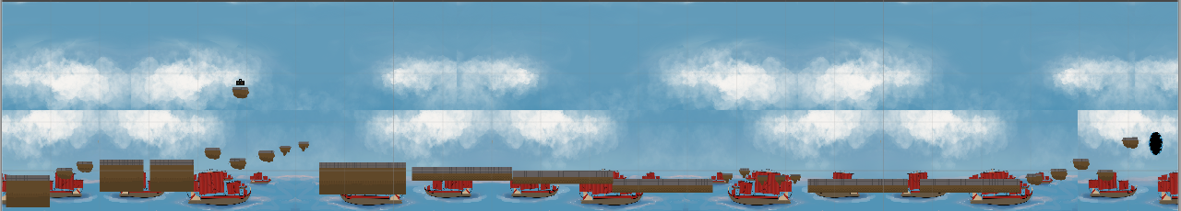
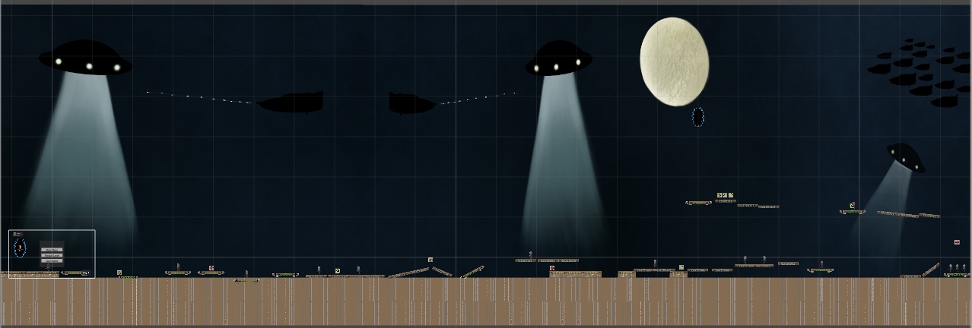
Level Design – Level 3 and 4

Slide 12
Game Implementation
For development we went with the Agile Development route. For the game it has worked extremely well
Kieran coded the game and developed small segments each day or two, tested them and either removed or added it to the overall structure.
Sent early alphas to the team and friends to play to test how something functioned
The original idea never really changed between idea and implementation
Most of the assets were created between Angelika and Steven
Originally we had it decided that we would create each level together as a team but the art work was taking longer than expected and Kieran was moving fast with the coding so we had to move forward and then go back when the art work was finished

Slide 13
Game Implementation - scripts
There are currently 28 scripts that make up the game. Some are duplicates to work with certain left and right animation and some are extremely fundamental on to how the game functions
Only 2 scripts weren’t written by me

Slide 14
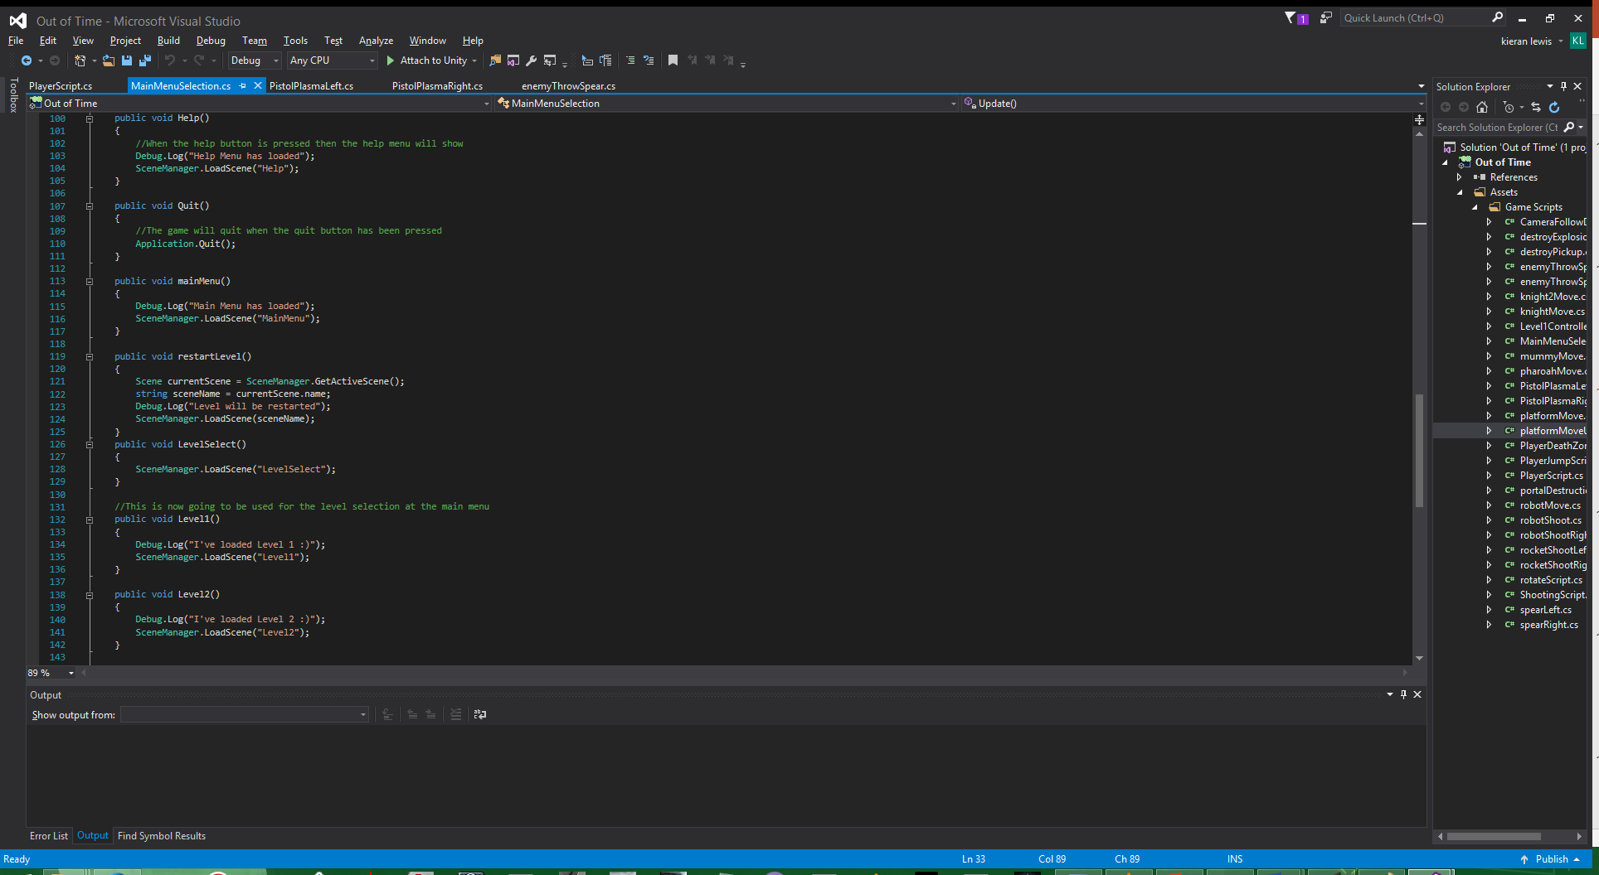
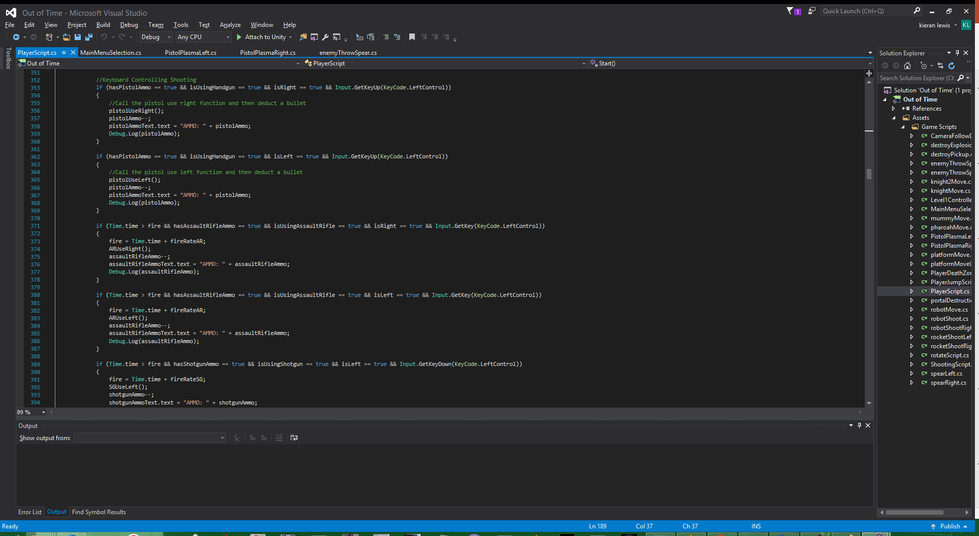
Game Implementation – scripts Continued

Slide 15
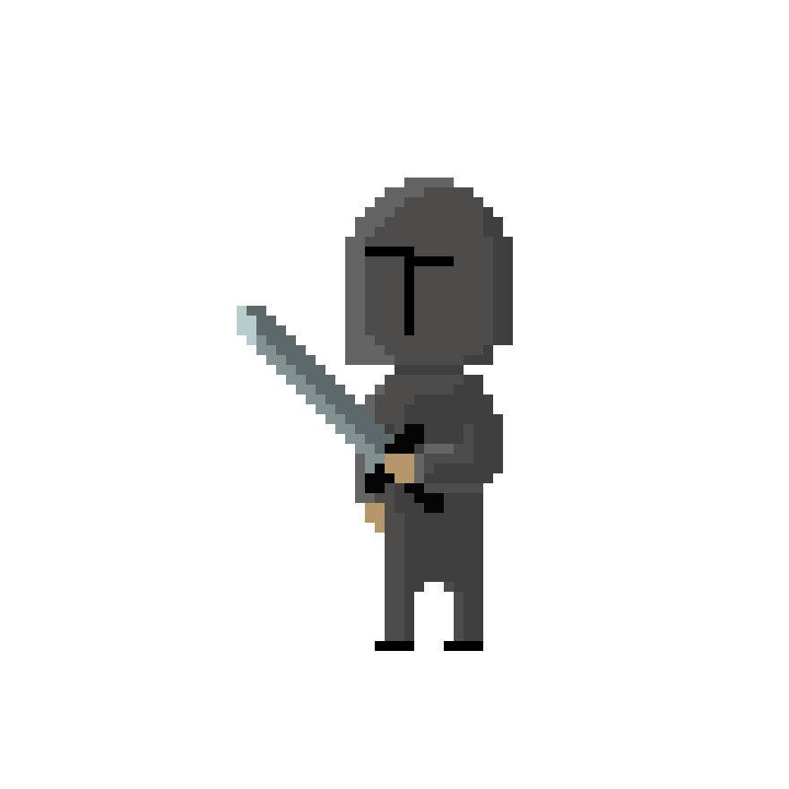
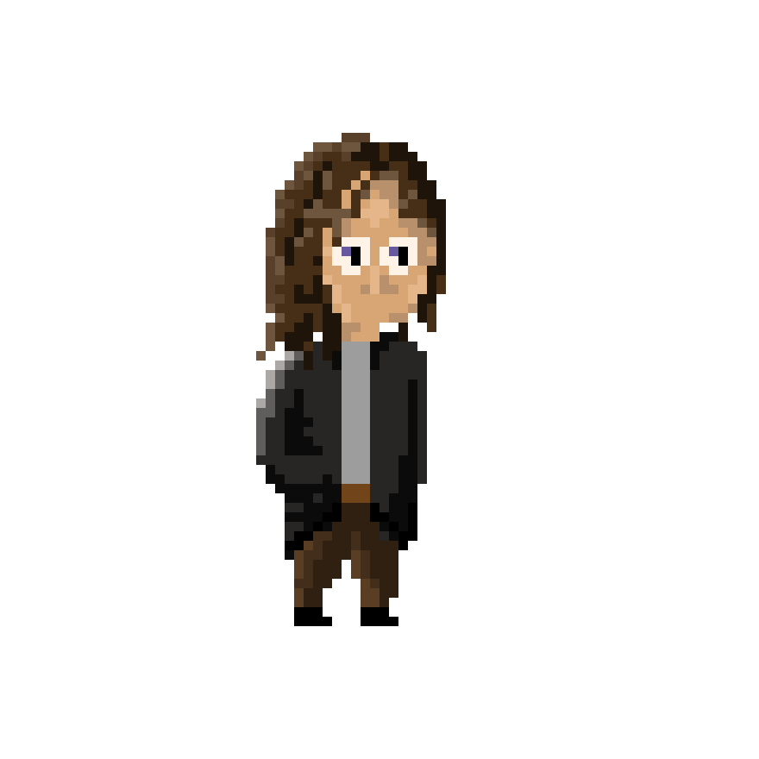
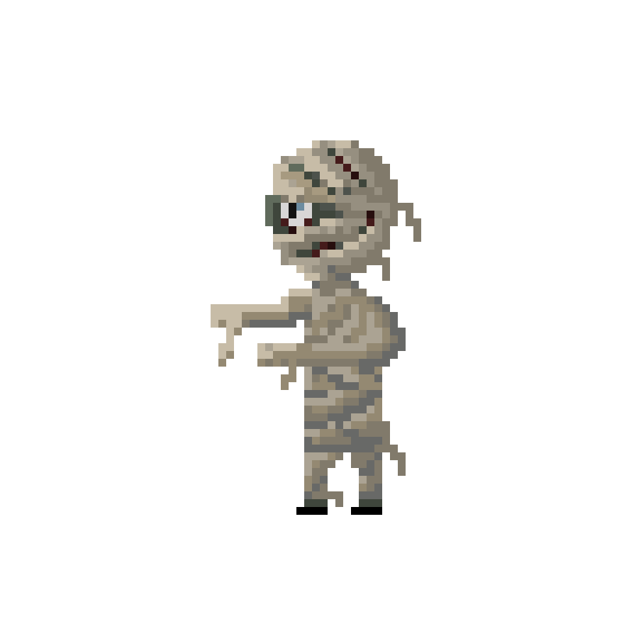
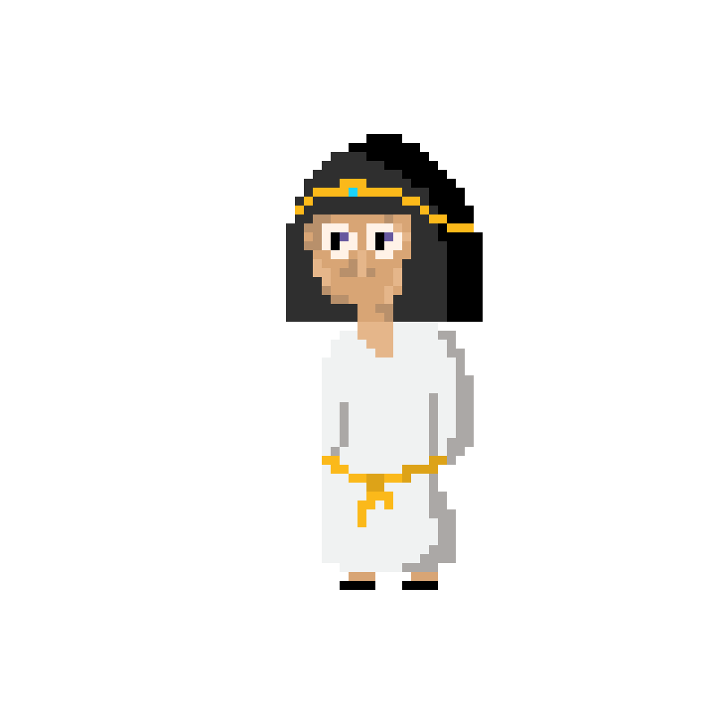
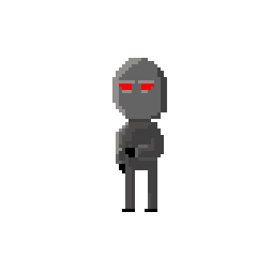
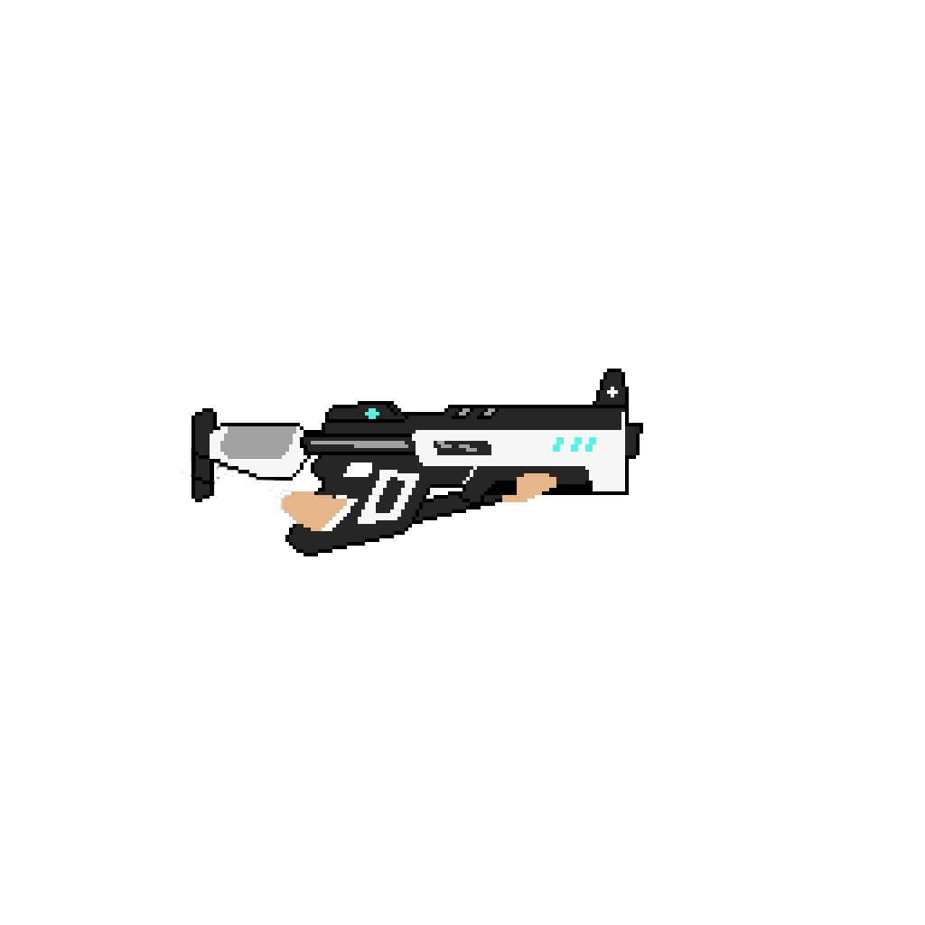


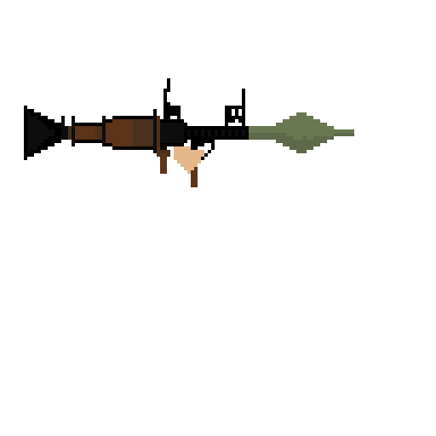
Game Implementation - Assets
Assets were mostly created between Steven and Angelika

Slide 16
Immersive Qualities
When it came to the art of the game Steven knew that there should be a clear difference between the foreground and background.
Again with the same idea in mind we tried to get the pixel art as close to the cultural realistic as possible so that the player wasn’t going “Something is off here!!!”

Slide 17
Version Control
For version control we used GitHub. It is really good for holding files but can have issues updating the repository due to unknown reasons.
Sometimes you would go onto GitHub and it would say it couldn’t gather the most recent Commit
GitHub allowed us to keep track of the latest version

Slide 18
Out of Time: Prototype Demo
The game is playable here if you want to try it out or you can view the videos of the game in action

Slide 19
Individual Contribution – Kieran Lewis
I programmed the game with the exception of two scripts, these two scripts were found online and have references to where.
I implemented all of the assets into the unity project and made sure everything worked. This was always the plan however since I am not an artist and I really enjoy programming and using Unity
The technical side of the Games Design Document and the story part was also done by me as I enjoy telling a story

Slide 20
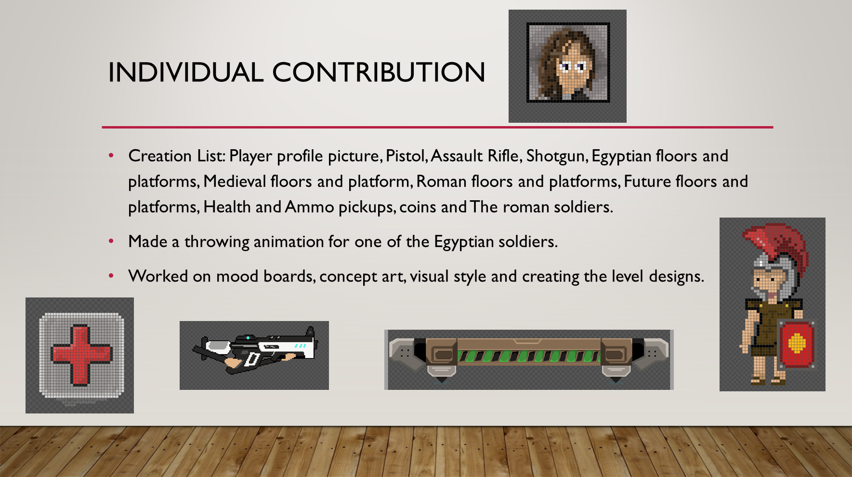
Steven Benson

Slide 21
Individual Contribution – Angelika kolodziej
Angelika took care mostly of the character. The way they look, the animations. She also has done backgrounds to each level.

Slide 22
Learning experience as a team
It was the first time Angelika needed to create a Game Design Document so both Kieran and Steven needed to guide her through it
It showed us what it was like if some people work faster than other as it shows how it can effect a project
It showed how it was important to share everything on a place where we could always edit, use or look at.

Slide 23
Future development
Collectibles are still needed to be added along with more enemies.
All enemies are available to implement but getting some things to work held back adding them

Slide 24
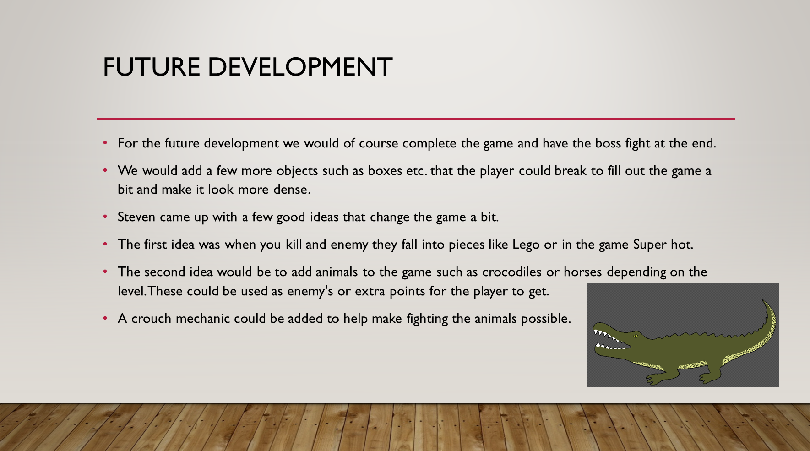

Slide 25
The End: Questions are welcome

